Slide 1

Programming – master dse pROJECT: pyworldtemp Pietro marincola

Slide 2

abstract
One of the main and controversial topic of the last decades is certainly the debate about Global Warming. Nowadays, researchers can rely on a huge quantities of data collected by sensors over the world about temperatures and others important features. The final goal to analyse temperature data, is to highlight insights or trends that can have negative impact for our planet, the Earth. Scientific communities and also the common people are today aware about the consequences that even 1 Celsius degree of difference may cause. In this work, we evaluate offline public dataset containing the global temperatures stored from 1743 to 2013 in 247 world cities. Unfortunately, results show that exist some relevant trends in the average temperature collected.

Slide 3





methodology
Regarding the experimental setup, I employed following tools & libraries:
pandas, numpy for dataset pre-processing.
scipy, seaborn, matplotlib for statistics analysis and graphs.
geopy, geopandas for geospatial analysis and data visualization.
tqdm for barchart support.
All of them are open source tools based on the Python language that counts with a good documentation as well as a wide range of Data Analysis techniques.
For code development, VS CODE and Jupyter Notebook are the two environments been used.
I started by importing the original dataset in a Pandas dataframe, analysing it to assess data quality and evaluating whether it is effected by noise. In the second step, dataframe has been explored and features evaluated . After having performed the two initial steps, analysis and data visualization have been performed. Finally, in the last step, external API have been invoked thought Geopandas library in order to obtain geospatial data.
Next slides are the result of analysis on data obtained by the procedure described above.

Slide 4
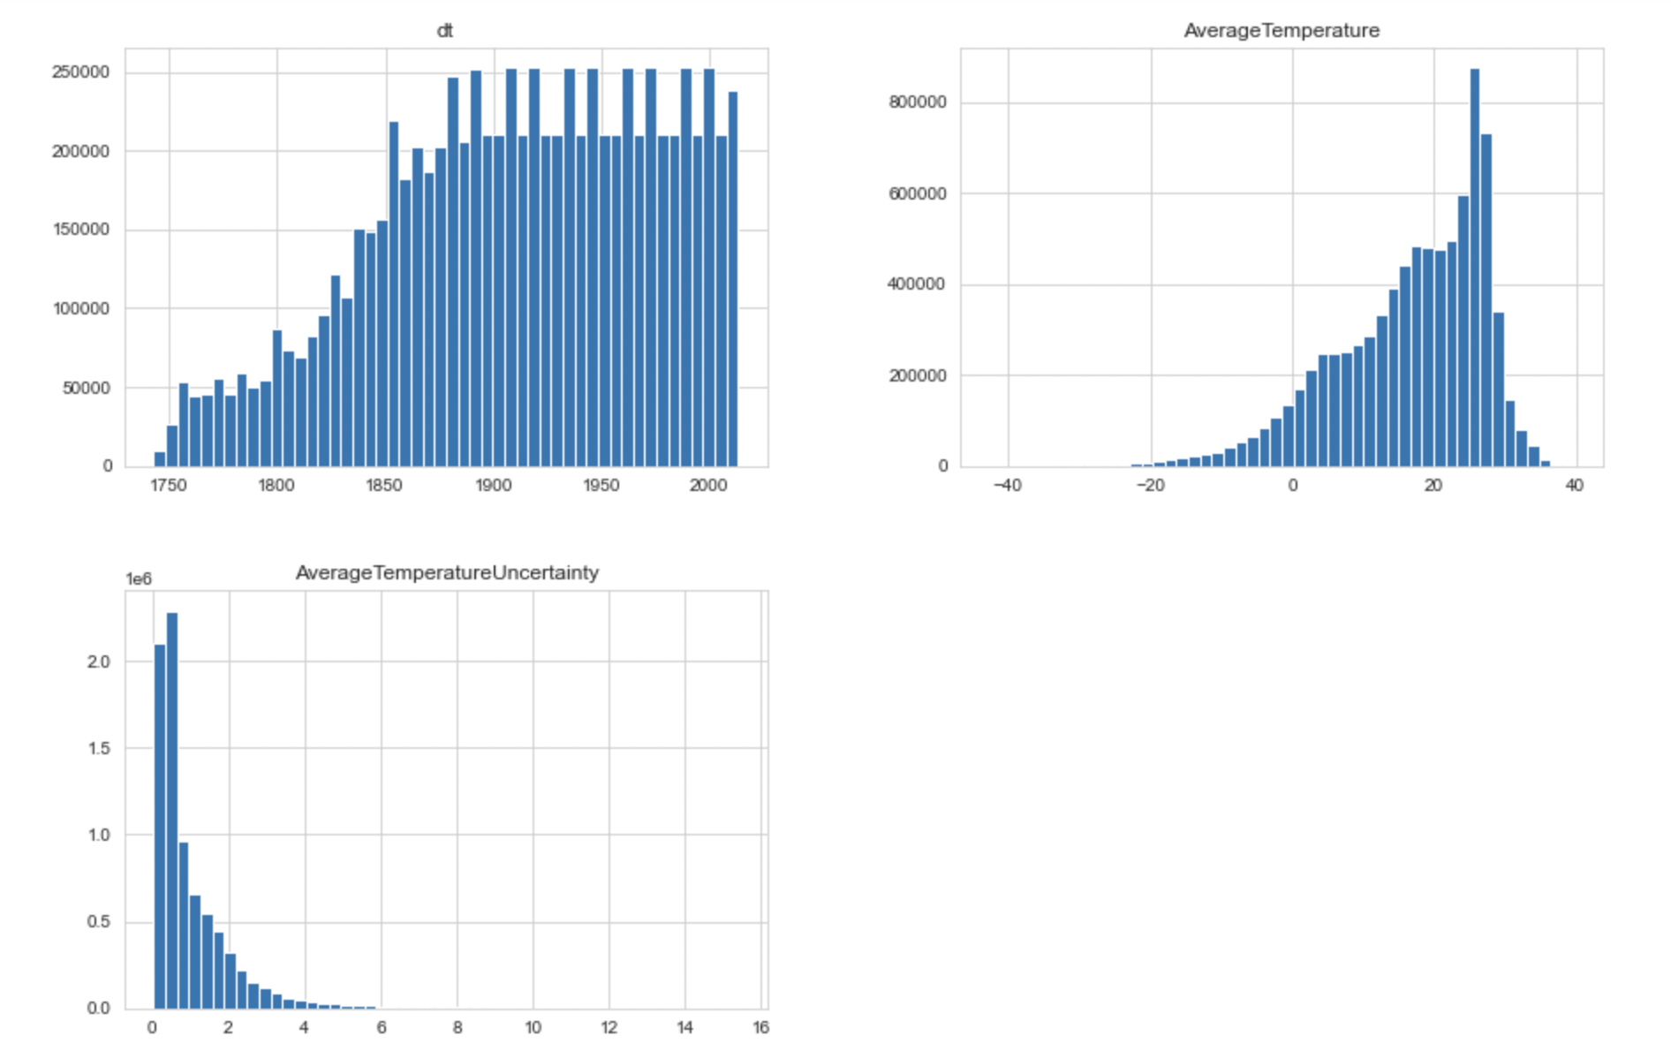
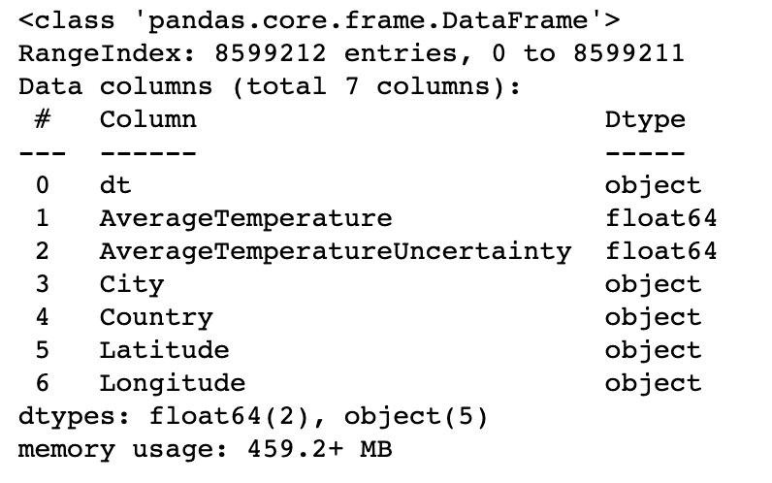
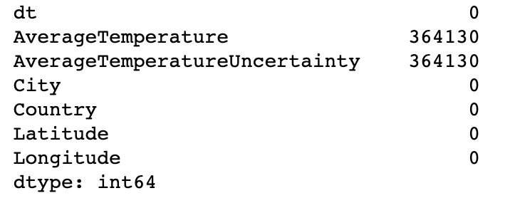
DATA QUALITY
1
Histograms for each numerical data show that the number of data collected increase over the years, AverageTemperature attribute extend on the right and AverageTemperatureUncertainly extend on the left.
For current purpose, in the set of attributes I’m interested in dt, AverageTemperature, AverageTemperatureUncertainly and City. The analysis will be performed on the cities geolocation where Latitude and Longitude have been obtained thought external API.
Looking the null values, we can obtain 364130 records in two attributes. The action performed to solve this potential issue is remove these records.
2
3

Slide 5
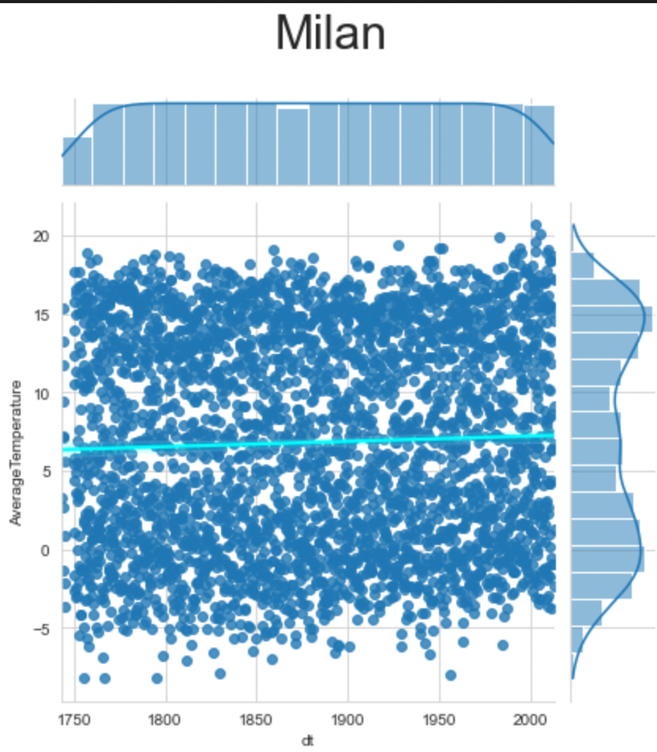
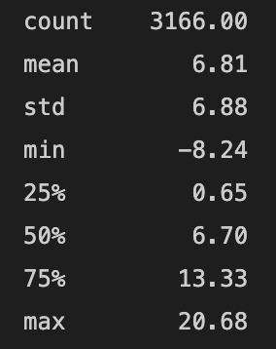
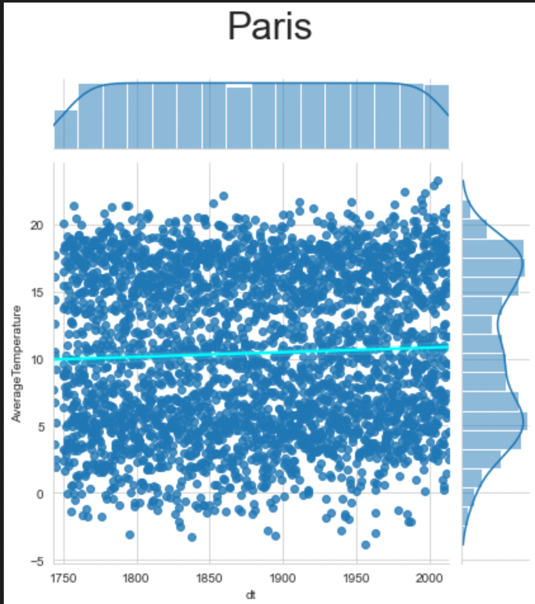
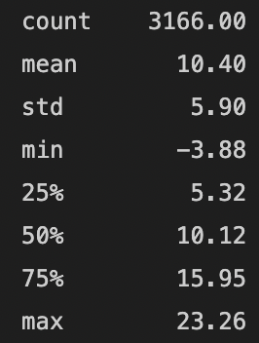
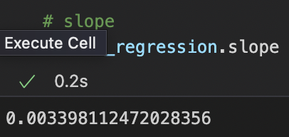
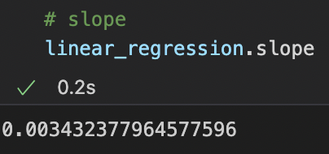
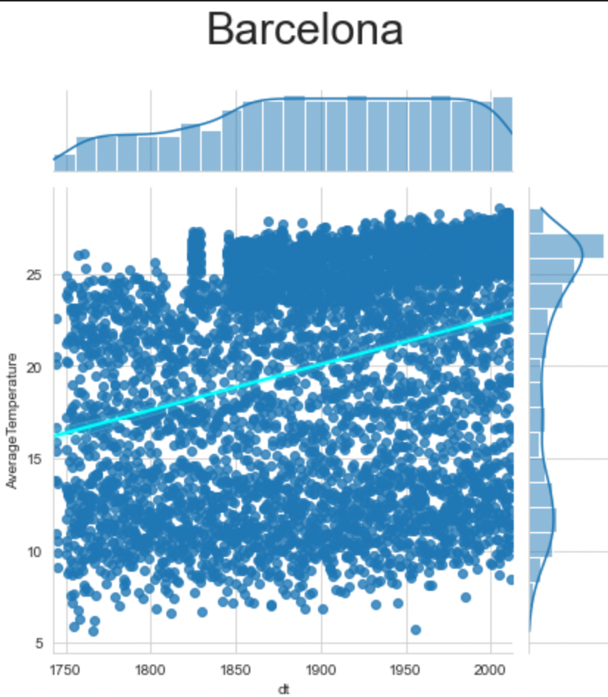
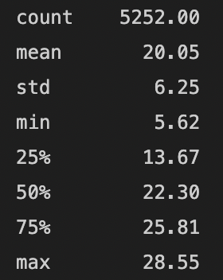
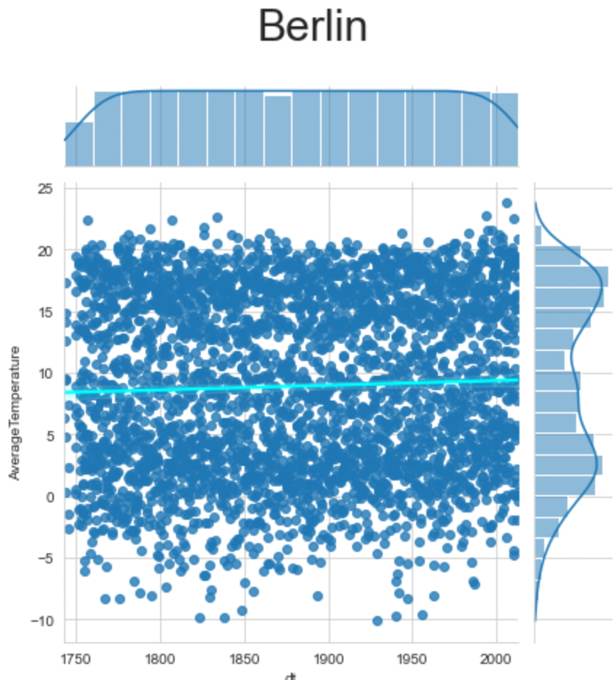
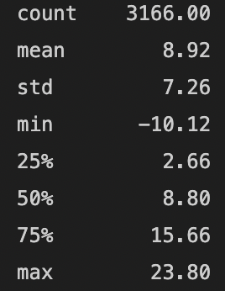
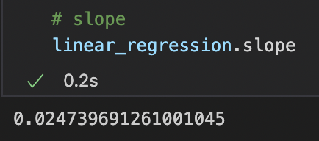
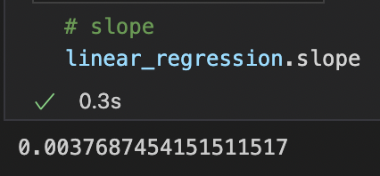
Main European cities temperature statistics
We can observe here that slope value for each of the selected cities is > 0 with a relevant (and alarming) trend value for Barcelona.

Slide 6
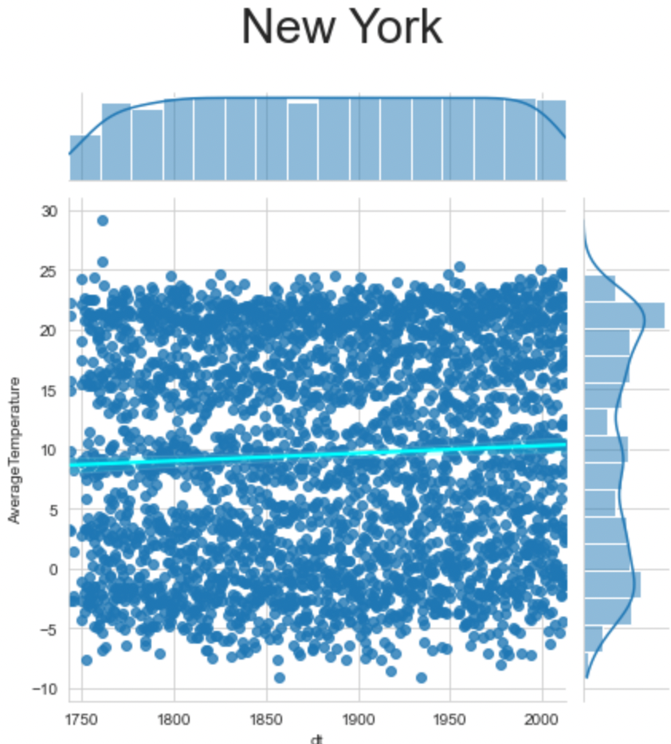
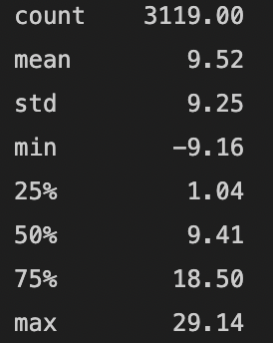
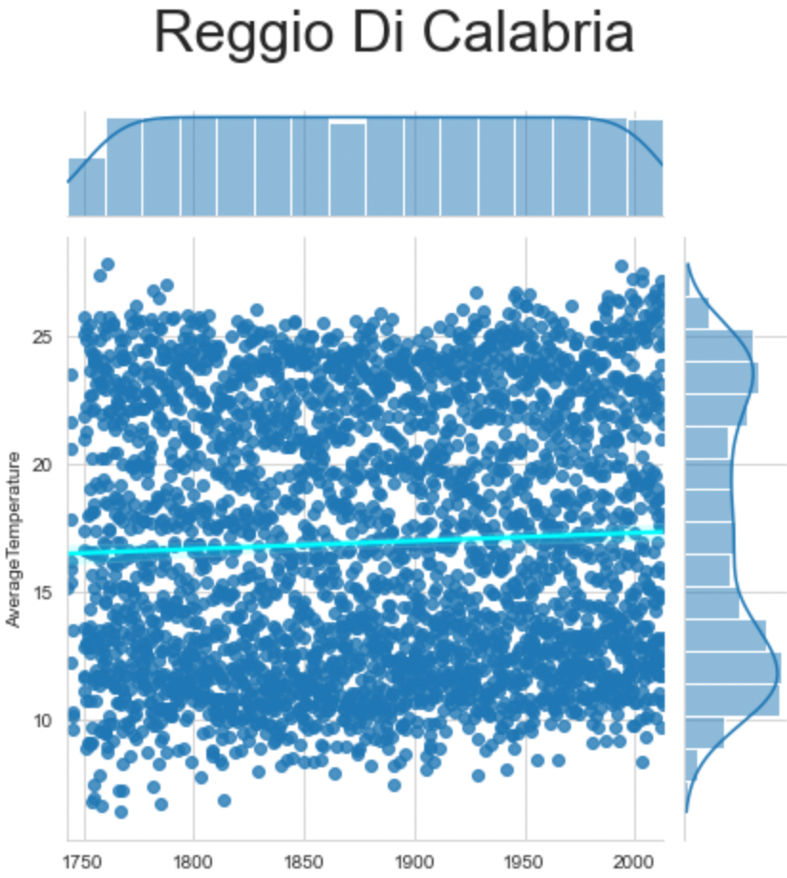
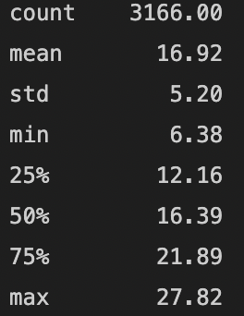
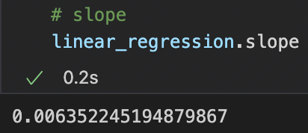
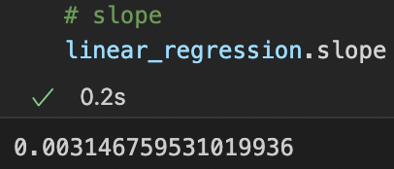
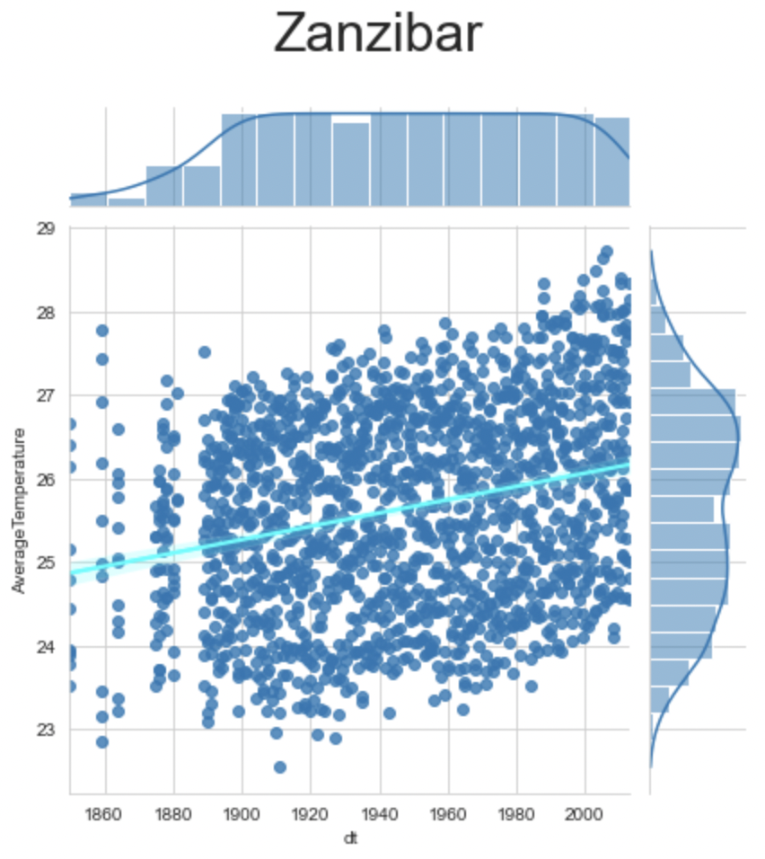
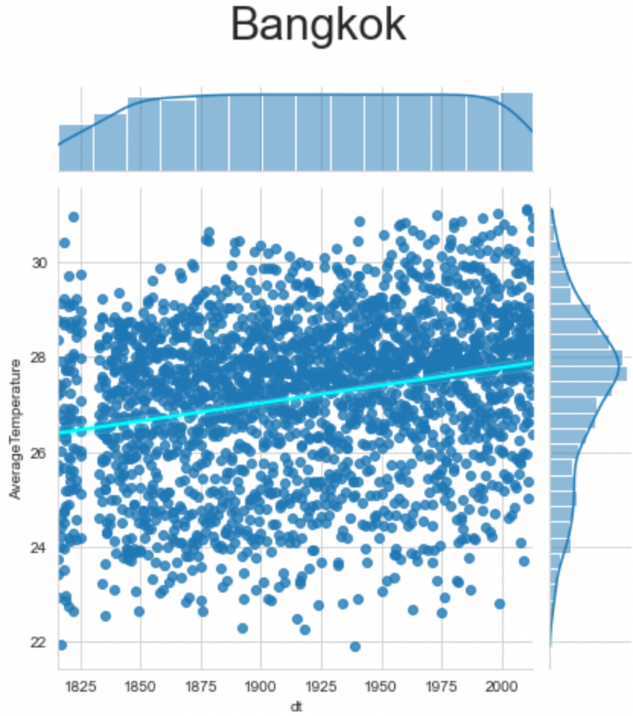
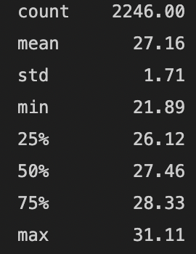
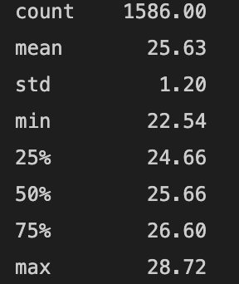
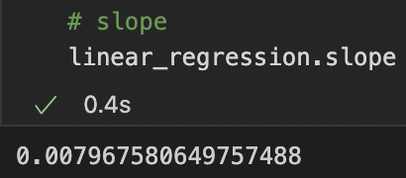
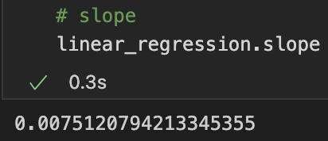
Main world cities temperature statistics
Similar observation is valid for others cities in the world.

Slide 7
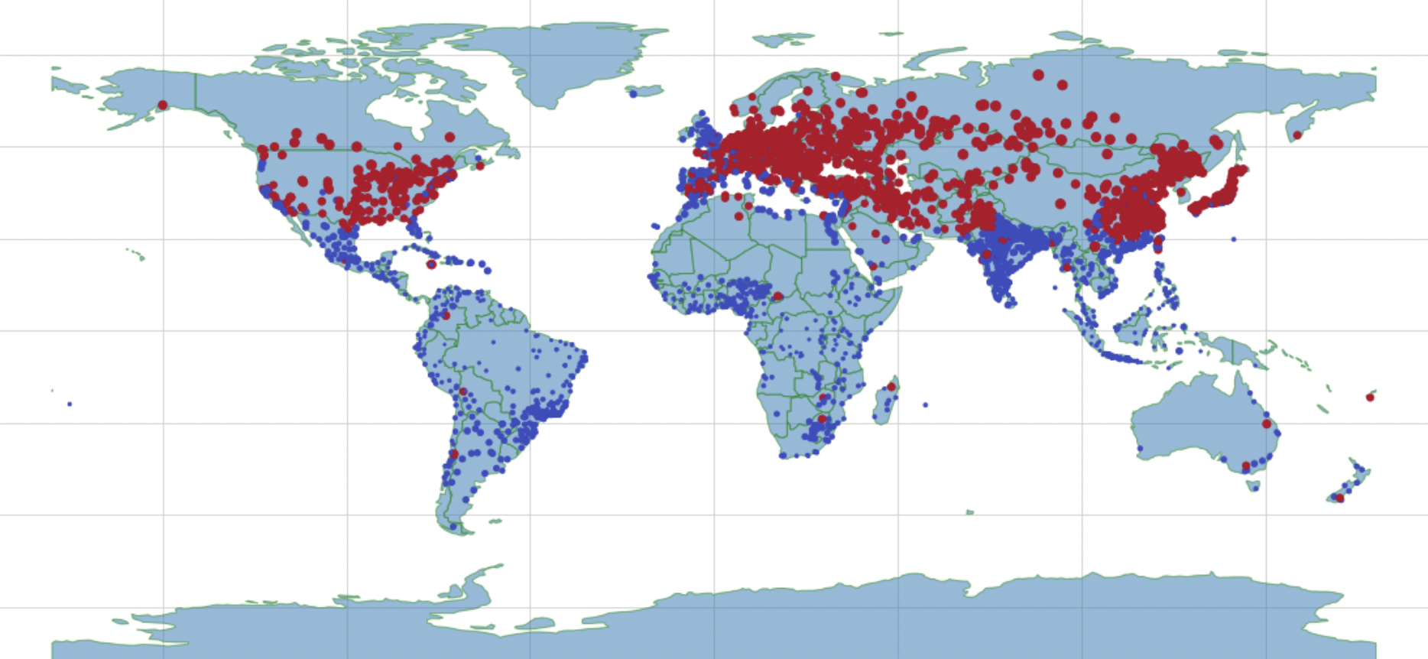
Temperature excursion report
For each city, the difference between maxTemperature and MinTemperature detected has been performed in order to calculate the excursion of temperature. We can notice some regions or continents that are more effected by the big temperature excursion.
Excursion value ≤ 25° in blue
Excursion value > 25° in red
Number of tracked cities: 3448

Slide 8
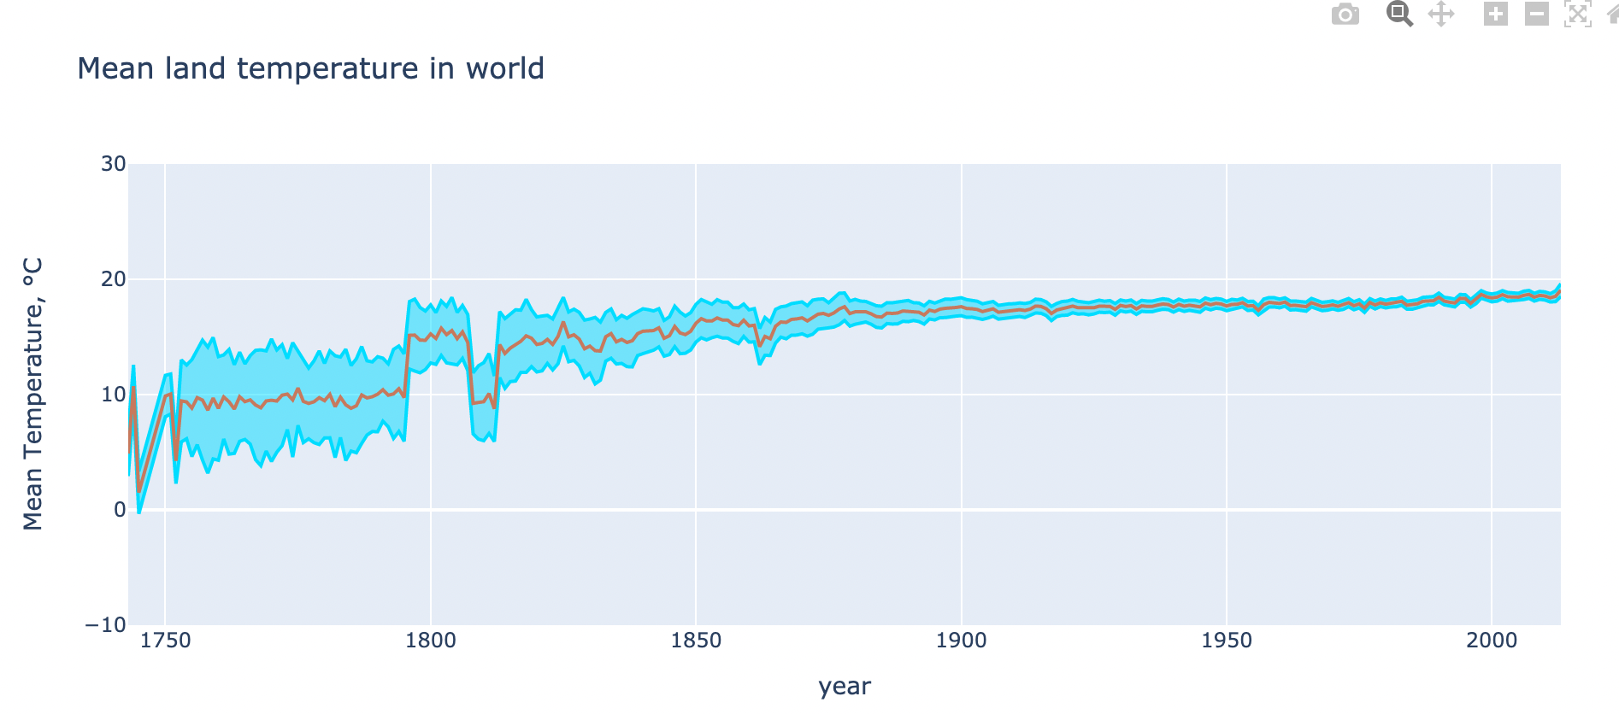
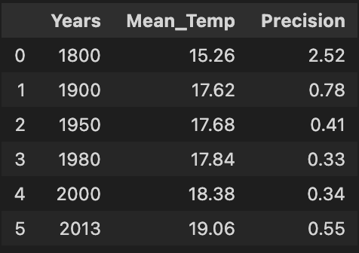
Earth mean temperature 1743-2013
In the first graph, using the data in AverageTemperatureUncertainty we can highlight in blue the accuracy of measures that year by year become more accurate. Instead, with red line it can be also observed a specific trend in the mean temperatures of the Earth.
The table on the right show the rising up of temperatures in some specific years of the last three Centuries.

Slide 9
conclusion
Everyone has to play their part!

